Slide 1
Money and Monetary policy
Md. Shawkat Ali
Professor
Department of Economics

Slide 2

Money
Money is any token or other object that functions as a medium of exchange that is socially and legally accepted in payment for goods and services and in settlement of debts.
Economists, however, use the word in a more specific sense: Money is the set
of assets in an economy that
people regularly use to buy
goods and services from
other people.

Slide 3
Money
Money includes:
Currency: particularly the many circulating currencies with legal tender status, and
Various forms of financial deposit accounts: such as demand deposits, savings accounts, and certificates of deposit. In modern economies, currency is the smallest component of the money supply.

Slide 4
Functions of Money
Three functions:
  medium of exchange,
  a unit of account, and
  a store of value

Slide 5
Functions of Money
Medium of exchange: Money is used as an intermediary for trade, in order to avoid the inefficiencies of a barter system. Such usage is termed a medium of exchange.
Medium of exchange is an item that buyers give to sellers when they want to purchease goods and services.
Unit of account: A unit of account is a standard numerical unit of measurement of the market value of goods, services, and other transactions. A unit of account is a necessary prerequisite for the formulation of commercial agreements that involve debt.
Store of value, an item that people can use to transfer purcheasing power from present to the future.

Slide 6
Liquidity
Economists use the term Liquidity to describe the case with which an asset can be converted into the economy’s medium of exchange. Because money is the economy’s medium of exchange, it is the most liquid asset available.
Assets vary widely in their liquidity. Most stock and bond can be easily sold with small cost , so they relatively liquid assets.

Slide 7
Types of money (Commodity money)
Commodity money is any money that is both used as a general purpose medium of exchange and as a tradable commodity in its own right. An example is coins made of precious metal.
Commodity-based currencies are often viewed as more stable, but this is not always the case. The value of a commodity-based currency as a medium of exchange depends on its supply relative to other goods and services available in the economy.
Historically, gold, silver and other metals commonly used in commodity-based monetary systems have been subject to regular and sometimes extraordinary fluctuations in purchasing power.
Commodity money's ability to function as a store of value is also limited by its nature. For example, copper and tin risk rust and corrosion, and gold and silver are soft metals that can lose weight through scratches and abrasions.

Slide 8
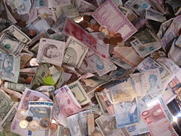
Types of money (Fiat money)

Slide 9
Fiat money
Fiat money is any money whose value is determined by legal means, rather than the strict availability of goods and services which are named on the representative note.
Fiat money is created when a type of credit money (typically notes from a central bank, such as the Bangladesh Bank) is declared by a government act (fiat) to be acceptable and officially-recognized payment for all debts, both public and private.

Slide 10
Money supply
The money supply is the amount of money within a specific economy available for purchasing goods or services. The supply in the US is usually considered as four escalating categories M0, M1, M2 and M3.
The categories grow in size with M3 representing all forms of money (including credit) and M0 being just base money (coins, bills, and central bank deposits). M0 is also money that can satisfy private banks' reserve requirements.
In the US, the Federal Reserve is responsible for controlling the money supply, while in the Euro area the respective institution is the European Central Bank. Other central banks with significant impact on global finances are the Bank of Japan, People's Bank of China and the Bank of England.

Slide 11
The measures of money
Symbol | Assets included
C/M₀ | Currency
M1 | Currency plus demand deposits, traveler’s check, other checkable deposits
M2 | M1 plus saving deposits, small time deposits
M3 | M2 plus large time deposits, Eurodollars,

Slide 12
Monetary policy
Monetary policy is the process by which a government, central bank, or monetary authority manages the money supply to achieve specific goals.
Usually the goal of monetary policy is to accommodate economic growth in an environment of stable prices. For example, it is clearly stated in the Federal Reserve Act that the Board of Governors and the Federal Open Market Committee should seek “to promote effectively the goals of maximum employment, stable prices, and moderate long-term interest rates.”
A failed monetary policy can have significant detrimental effects on an economy and the society that depends on it. These include hyperinflation, stagflation, recession, high unemployment, shortages of imported goods, inability to export goods, and even total monetary collapse and the adoption of a much less efficient barter economy. This happened in Russia, for instance, after the fall of the Soviet Union.

Slide 13
Tools to control money supply
Open market operations (selling or buying bonds)
Raising or lowering bank reserve requirements
Bank rates

Slide 14
The Quantity Equation
In this section we will discuss the quantity theory of money,
discuss inflation and interest rates, and
the relationship between the nominal interest rate
and the demand for money.
This model allows us to see the effect that the quantity of money has on the economy.
To do this we must see how the quantity of money is related to price and incomes.

Slide 15



The Quantity Equation
The velocity of money refers to the speed at which the typical dollar bill travels around the economy from wallet to wallet.
Economists usually use GDP “Y” as a proxy for “T” since data on the number of transactions is difficult to obtain.

Slide 16
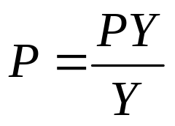

Money, Prices, and Inflation
…in percent terms:
This equation shows the relationship between change in money supply and inflation

Slide 17
Money Supply, Money Demand, and Monetary Equilibrium
Money demand has several determinants, including interest rates and the average level of prices in the economy.
People hold money because it is the medium of exchange.
  The amount of money people choose to hold depends on the prices of goods and services.
In the long run, the overall level of prices adjusts to the level at which the demand for money equals the supply.

Slide 18
Money Supply, Money Demand, and the Equilibrium Price Level
Value of
Price
Money (1/P)
Money supply
Level (P)
(High)
1
1
(Low)
3/4
1.33
A
Equilibrium value of money
1/2
2
Equilibrium price level
1/4
4
Money
demand
(Low)
0
(High)
Quantity fixed
Quantity of
by the Fed
Money

Slide 19
The Effects of Monetary Injection
Value of
Price
Money (1/P)
MS₁
MS₂
Level (P)
(High)
1
1
(Low)
1. An increase in the money supply...
3/4
1.33
2. ...decreases the value of money ...
A
1/2
2
3. …and increases the price level
B
1/4
4
Money
demand
(Low)
0
(High)
M₁
M₂
Quantity of
Money

Slide 20
Money, Prices, and Inflation
So, the quantity theory of money states that the central bank, which controls the money supply, has ultimate control over the rate of inflation.
If the central bank keeps the money supply stable, the price level will be stable. If the central bank increases the money supply rapidly, the price level will rise rapidly.

Slide 21
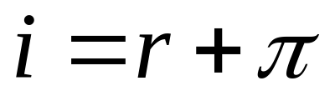
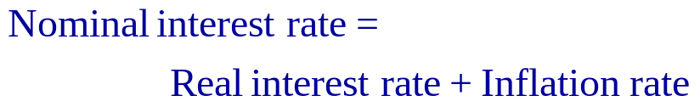
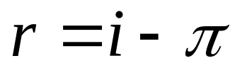
Inflation and the Interest Rate

Slide 22
An expansionary monetary policy:
Can be applied in case of unemployment and recession
i
Ms
Ms₂
i
i₂
Md
Qm
q
q₂
If the central bank increases the money supply lower
interest rate stimulate consumption and investment
expenditure , i.e increases AE (other things are kept same)

Slide 23
A contractionary monetary policy :
Can be applied in case of an inflation
Ms₂
i
Ms
i₂
i
Md
q₂
Qm
q
If the central bank reduces the money supply raise
interest rate reduced consumption and investment
expenditure , i.e reduce AE (other things are kept same)

